Slide 1


Slide 2
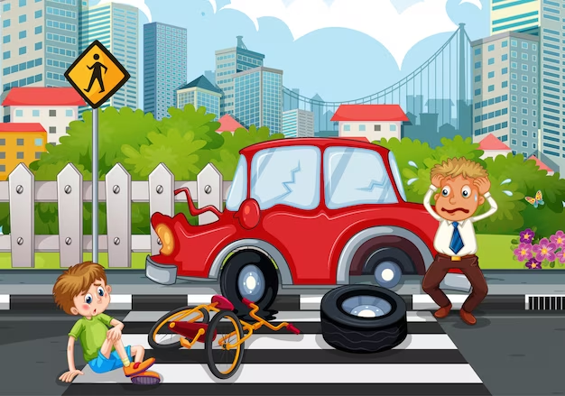
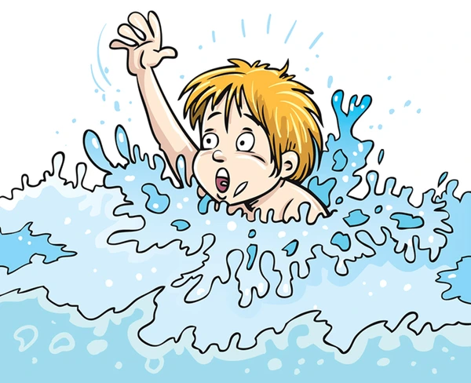


Slide 3
General Objectives
At the end of the teaching learning session , BNS 1st
year students will be able to explain about accident and
injury in preschool .

Slide 4
Accident and Injury
in Preschool
Prepared by :
Prativa Shah
BNS 2nd year

Slide 5
Accident and Injury
An accident is an unexpected or unintended event
that results in damage, injury, or harm to people,
property, or the environment .
An injury is damage or harm to the body, usually
caused by an accident, a physical activity, or a
disease.

Slide 6
Accidents and injuries (childhood emergencies) are the serious condition that threatens the life of an child which requires medical attention. Sometimes it can even cause death of a child . So, understanding on common accidents and injuries and their first aid management is vital for every health care provider .

Slide 7
Common accidents and injuries
1. Fall
2. Road traffic accidents
3. Drowning
4. Suffocation
5. Aspiration
6. Burn

Slide 8
1.Fall
Fall means a sudden loss of balance, a stumble, or a collapse.
Falling is a common occurrence among preschool-aged
children, as they are still developing their balance,
coordination, and motor skills .

Slide 9
Cause of fall
Lack of balance and coordination: Preschool-aged children
are still developing their balance and coordination, which
can lead to falls.
Running or playing too fast: Children may fall when they
are running or playing too fast, especially if they are not
paying attention to their surroundings

Slide 10
Slippery or uneven surfaces: Children may slip on
surfaces that are wet, slippery, or uneven, such as a wet
floor or a playground surface that has not been properly
maintained.
Poor lighting: Inadequate lighting can make it difficult for
children to see obstacles or hazards, increasing their risk of
falling.

Slide 11
Lack of adult supervision: A lack of adult supervision
can increase the risk of falls, as children may engage in
unsafe behaviors or activities without proper guidance.
Health or medical conditions: Certain health or medical
conditions can affect a child's balance and coordination,
increasing their risk of falling.

Slide 12
Prevention of fall
Ensure appropriate size of clothes and shoes for child.
Keep the floor clean and dry.
Provide safe play areas and safe play materials.
Keep supervision of children’s play activities.
Teaching balance and coordination .

Slide 13
2.Road traffic accidents
A road traffic accident (RTA) refer to any accident involving
at least one road vechicle, occurring on a road open to public
circulation, and in which at least one person is injured or
killed.
Among road traffic accidents, motor vechicle accident is
the most common .

Slide 14
Causes of road traffic accident
Unrestricted freedom
Unawareness of danger within the environment
Development of motor activities with increasing age

Slide 15
Prevention of road traffic accident
Educate children on road safety: Teach children about road
safety rules, such as looking both ways before crossing the
street, using pedestrian crossings, and holding hands with an
adult while crossing the road.
Supervise children: Ensure that children are always
supervised while crossing the road . This can be done by
teachers, parents, or other responsible adults

Slide 16
Install speed bumps: Install speed bumps or other traffic
calming measures to reduce the speed of vehicles near the
preschool.
Use reflective materials: Ensure that children are visible
to drivers by using reflective materials on their clothing or
backpacks.

Slide 17
Modify the environment: Make the preschool
environment safe by ensuring that the area near the school is
free from traffic congestion and that there are designated
areas for children to cross the road safely.
Use safety measures: Ensure that children are using
helmet while riding bicycle.

Slide 18
3.Drowning
Drowning is the process of experiencing respiratory
impairment from submersion or immersion in liquid .
It causes aspiration of liquid in respiratory tract and alveoli
which leads to decreased oxygen concentration in alveoli and
impairment in normal expiration and inspiration function. It
leads to hypoxemia. Hypoxemia for long time damage the
vital organs and death may results.

Slide 19
Causes of drowning
Negligence of parents
Water resources near home and unsafe swimming pool
Undefined curiousity of children
Disease condition of child such as seizure disorders

Slide 20
Types
Survivors with drowning can be grouped into three categories depending on their severity of illness.
Category A patients are awake and conscious.
Category B patients are stuporous, have respiratory distress,
cyanosis, and hypothermia.
Category C patients are comatose and may be in flaccid or
stiffness. Ultimately they have respiratory failure and apnea.

Slide 21
Treatment
The net result of drowning is hypoxia, aspiration, and
hypothermia.
Initial resuscitation should be started immediately as
described for basic life support protocol.
Category A and B patients require supportive care.
Category C victims require advanced life support care.
Also look for any injuries of spine or neck.

Slide 22
Diuretics are administered for pulmonary edema.
Sodium bicarbonate may be given for metabolic acidosis.
Steroids are not indicated.
Convulsions are treated with diazepam and phenobarbital or phenytoin.
Morphine is used for sedation in Category C patients.

Slide 23
Hypothermia is managed by adequate warming. There is still controversy over what temperature range should be maintained in patients recovering from drowning Mechanical ventilation may be needed for respiratory compromise and should be directed towards providing normocarbia and adequate oxygenation.

Slide 24
Prevention
Victims of drowning have a very slim chance of survival after
immersion. The victim loses consciousness after
approximately 2 minutes of immersion and irreversible
brain damage can take place after 4-6 minutes. Therefore,
prevention strategies are more important.

Slide 25
Preventing drowning in preschool children requires a
combination of supervision, education, and environmental
modifications. Here are some preventive measures that can
help to reduce the risk of drowning in preschool children.
Supervise children: Always supervise children when they
are near water, whether it's a pool, bathtub, or any other body
of water. Supervision should be constant and attentive, with no
distractions such as phone calls or other activities.

Slide 26
Teach water safety: Teach children about water safety
rules, such as not running near water, not jumping into water
without adult supervision, and not swimming alone.
Use barriers: Install barriers such as fences or gates around
pools and other bodies of water to prevent access when not in
use.
Educate parents: Educate parents about water safety and
encourage them to supervise their children when near water.

Slide 27
Use life jackets: Ensure children wear appropriately sized
and properly fitting life jackets when participating in water
activities such as boating or swimming.
Teach swimming: Consider enrolling children in
swimming lessons to teach them basic water safety skills and
how to swim.

Slide 28
4. Suffocation
Suffocation is defined as the condition of being
deprived of oxygen ( as by having breathing stopped ) .
It occurs when air exchange is hindered or obstructed
due to covering of the mouth or nose, or applying
pressure to the throat and chest , or due to entrapment in
closes area .

Slide 29
Prevention
Cut food into small pieces.
Avoid foods that are hard to swallow , and chew like (hard candy ,
lollipops, nuts etc ) .
Make sure dentures are in place . Report loose fitting dentures.
Keep small objects like coins and marbles out of reach .
Plastic bags of any size should be kept out of reach .
Keep comforters , pillows and blankets out of baby’s sleep area.

Slide 30
Summary
1.What are the common accidents and injuries in preschool?
2. What is road traffic accident and its causes?

Slide 31
Home Assignment
1. Write short notes on drowning .

Slide 32
Plan for next class
Aspiration
Burn

Slide 33
References
M. Mankesari (2022),Comprehensive Textbook of Child Health Nursing,1st edition, Samikshya publication, Page no:685,693,694,698
U. Kamala(2018),Essential of Child Health Nursing, 2nd edition , Akshav publication, Page No : 719,725
Ghai , O.P (2019), Ghai Essentials Pediatrics( 9th edition) , Page No : 704, 707

Slide 34
S. Tumla, Nursing Care of Children, 1st edition,Medhavi Publication, Page No: 490,492
S. Bharati , Essential Textbook of Nursing Care of Children , Samiksha Publication , Page No :338
https://www.health of children.com

Slide 35


